Slide 1
Representative
Compound pic
X examples
Potent in vivo
(key data)
[Image of PfATP4]
Mechanism of Action:
PfATP4
All data public domain through open source consortium
[OSM logo]

Slide 2
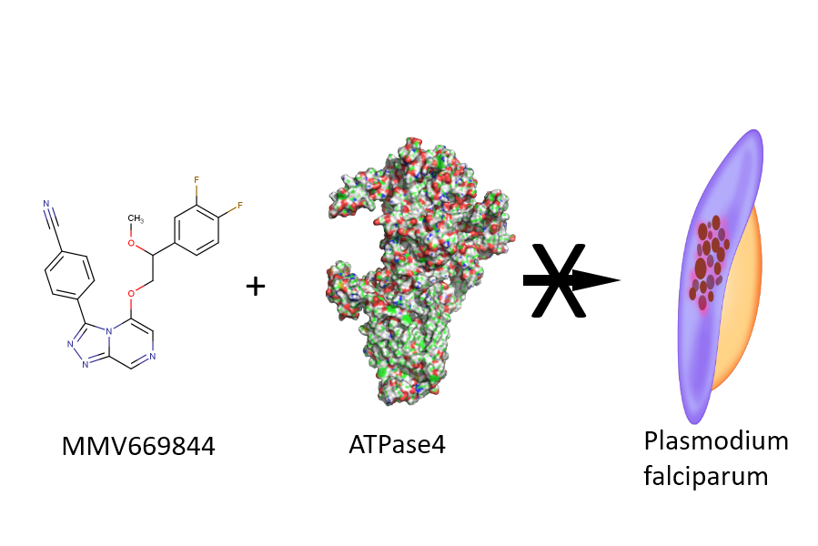

Mechanism of Action:
PfATP4
All data public domain through open source consortium

Slide 3
Mechanism of Action:
PfATP4
All data public domain through open source consortium

Slide 4
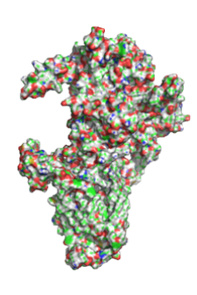
Mechanism of Action
PfATP4
All data public domain through open source consortium

